Slide 1
Modeling Terminology for Chemical Safety
Leah McEwen
Work begun at VoCamp 2016, University of Maryland
Notes:
http://vocamp.org/wiki/GeoVoCampDC2016
Exploratory phase
Analyzing and structuring data
Looking at frameworks and ontology patterns
Additional help from Gang Fu, Cogan Shimizu

Slide 2
Lab Safety Model for Reported Incidents
Notes:
Lab safety community model for reported incidents, to break down threats and barriers/controls for future planning
Center is a loss of control of a hazardous situation
Left side are variables and preventative options leading up to a potential event
Right side are variables and mitigation options after control is lost
Essentially – this terminology project will help associate these factors based on the data to populate the bowtie diagram as a knowledge base

Slide 3
Use cases
Support core questions in the risk assessment decision process
Conceptual analysis of research laboratory procedures
Identification of prevention and mitigation controls for multiple hazard types
Incident analysis including threats, consequences, and loss of control
Annotate collections of chemical incident data and other text-based information relevant to chemical health and safety
Support use of hazard recognition and evaluation tools (RAMP)
Inform templates for further reporting and build knowledge-base
Notes:
Support use of hazard recognition and evaluation tools
Inform templates for further reporting, to further build knowledge-base

Slide 4
Decision Process For Safety Assessment
RAMP: goal is to identify what and how to implement safety controls (mitigation) for a particular chemical scenario:
Recognize Hazards – chemical disposition, process (and players)
Assess Risk – connecting factors (dispositions + process + conditions)
Manage Controls – determine equipment, procedures
Prepare for Emergency – equipment, procedures, personnel

Slide 5
Core Chemical Safety Queries
What substances meet a given set of criteria for hazardous properties?
What is the consequence of exposing one particular substance to another under a particular condition?
What conditions and tasks are associated with leading to hazardous events for a given set of substances?
What are the exposure routes of substances and what controls protect from these types of exposure?
What mitigation strategies could be used to ameliorate the effect of exposure to a particular hazard?
*based on ACS CCS Safety Advisory Panel core questions, 2016
Notes:
Michelle | great complementary work, right side of the bowtie, also of interest in risk assessment:
What is the consequence of exposing a particular object to a particular hazard for a particular amount of time?– What are the hazards to a particular object at a particular geographic location?– What hazards are capable of causing a given consequence?– What susceptibilities could result in negative consequences to an object exposed to a particular hazard?– What mitigation strategies could be used to effect exposure to a particular hazard?

Slide 6
GOAL: associate patterns of these factors
Arsine, phosphine, and tetraborane are all oxidized explosively by fuming nitric acid.
Phosphine, hydrogen sulfide, and selenide all ignite when fuming nitric acid is dripped into the gas.
Hydrogen telluride ignites with cold concentrated nitric acid, sometimes exploding.
Substances
Outcomes
Consequences
Conditions
Operations
Apparatus/ equipment
https://pubchem.ncbi.nlm.nih.gov/compound/nitric_acid
Notes:
[primary data set includes incident strings described in Brethericks Handbook of Chemical Reactivity,
reproduced in PubChem (courtesy of HSDB), and Pistoia Chemical Safety Library (CSL) data, and ACS safety reporting requirement]
Informal tagging by some chemical safety officers
*add slide that says Pistoia CSL and ACS pubs requirements
*other initiatives & next steps (this group) – including how we connect

Slide 7
Data from Reported Incident Strings
Arsine, phosphine, and tetraborane are all oxidized explosively by fuming nitric acid.
Phosphine, hydrogen sulfide, and selenide all ignite when fuming nitric acid is dripped into the gas.
Hydrogen telluride ignites with cold concentrated nitric acid, sometimes exploding.
https://pubchem.ncbi.nlm.nih.gov/compound/nitric_acid
Notes:
[primary data set includes incident strings described in Brethericks Handbook of Chemical Reactivity,
reproduced in PubChem (courtesy of HSDB), and Pistoia Chemical Safety Library (CSL) data, and ACS safety reporting requirement]
Informal tagging by some chemical safety officers
*add slide that says Pistoia CSL and ACS pubs requirements
*other initiatives & next steps (this group) – including how we connect

Slide 8
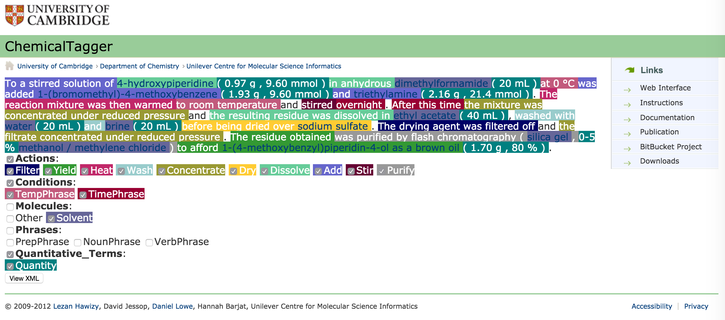
Chemical Procedure parser
Notes:
ChemicalTagger designed to parse chemical procedure text for organic reactions, output XML data
We are developing an approach to call this output, along with some additional analysis

Slide 9
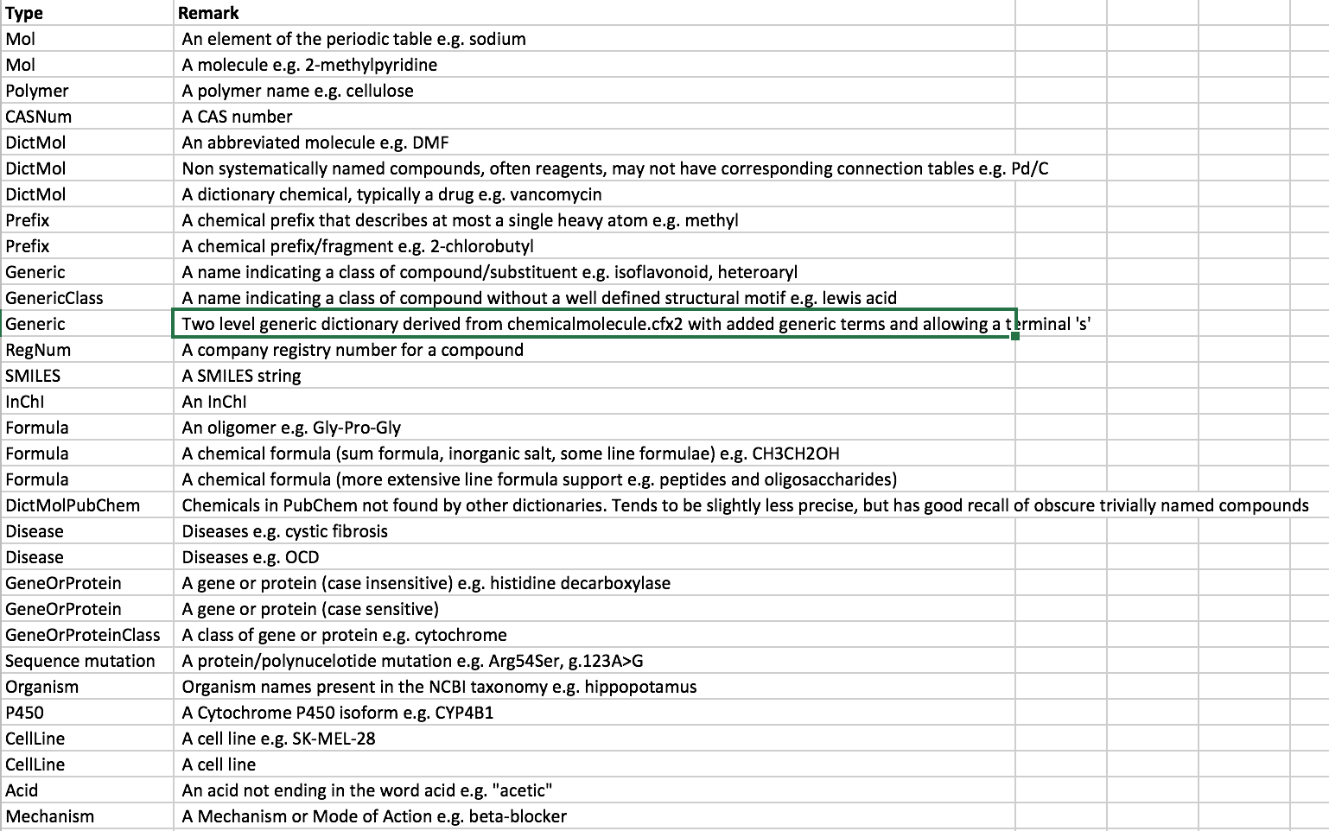

Slide 10
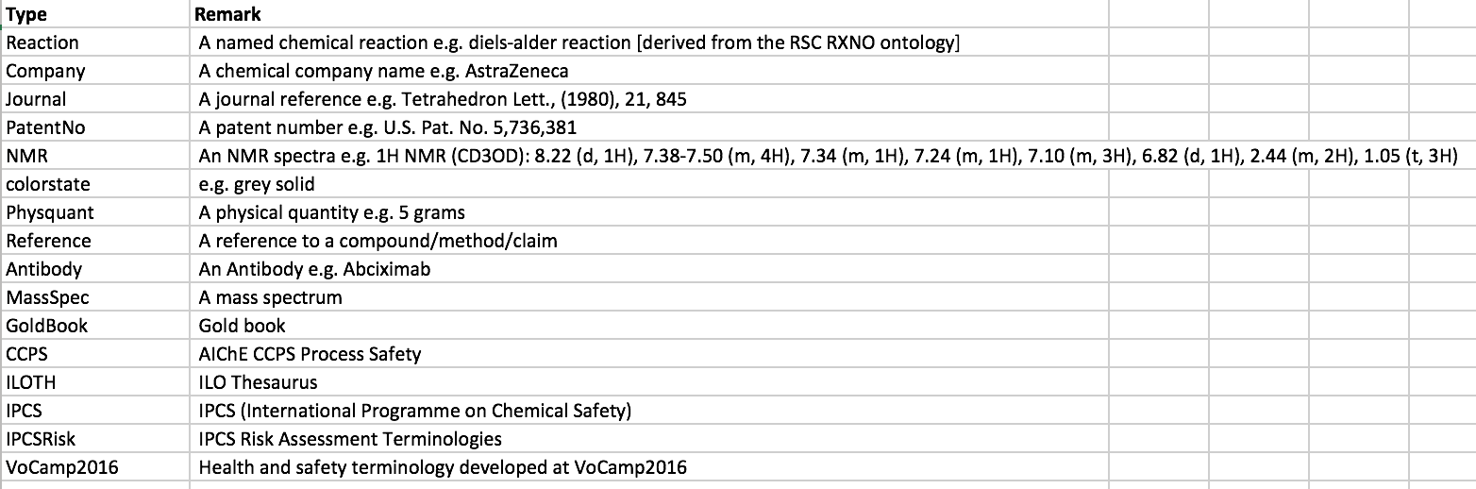

Slide 11
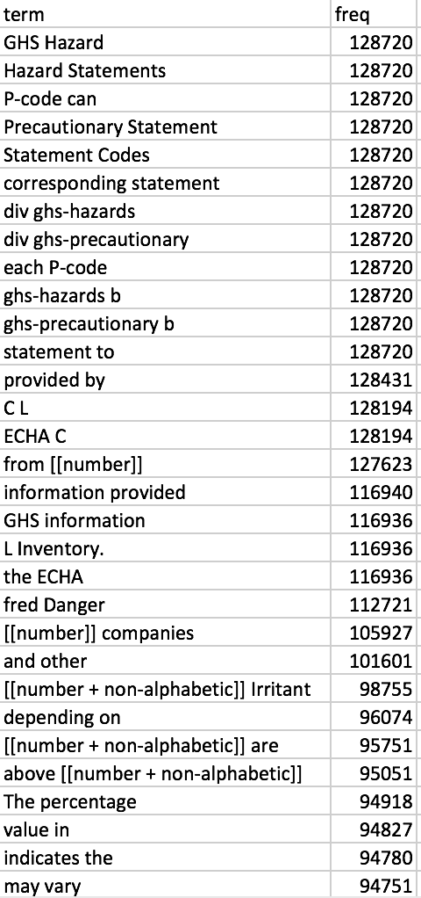
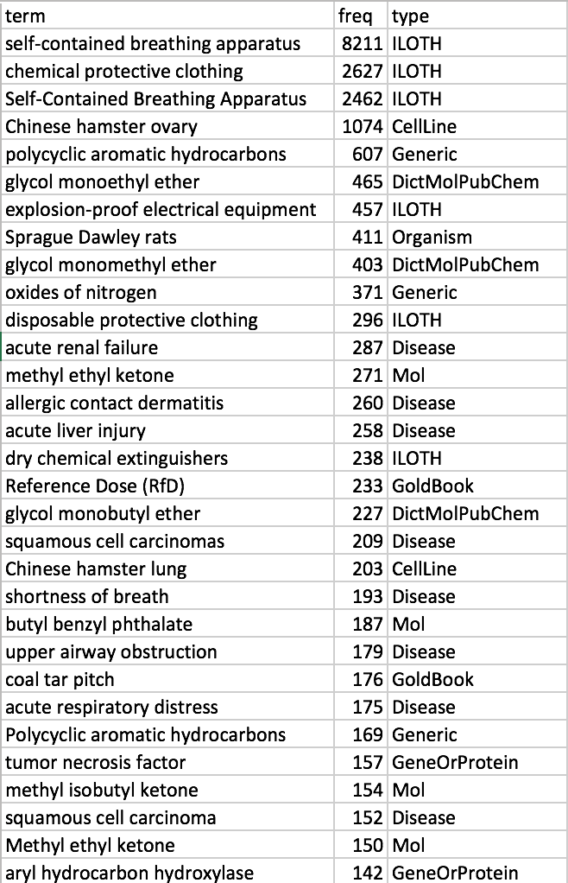

Slide 12
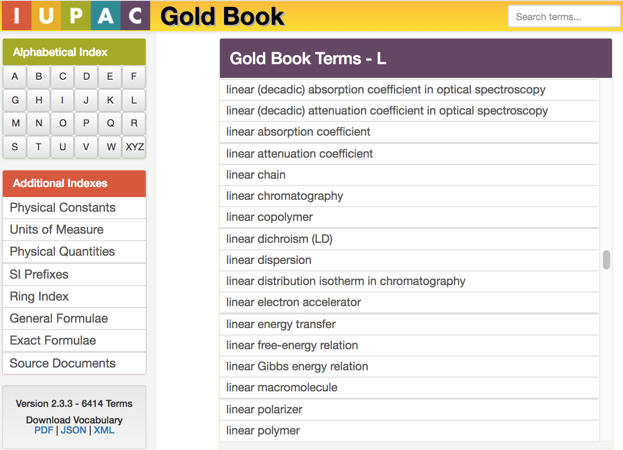
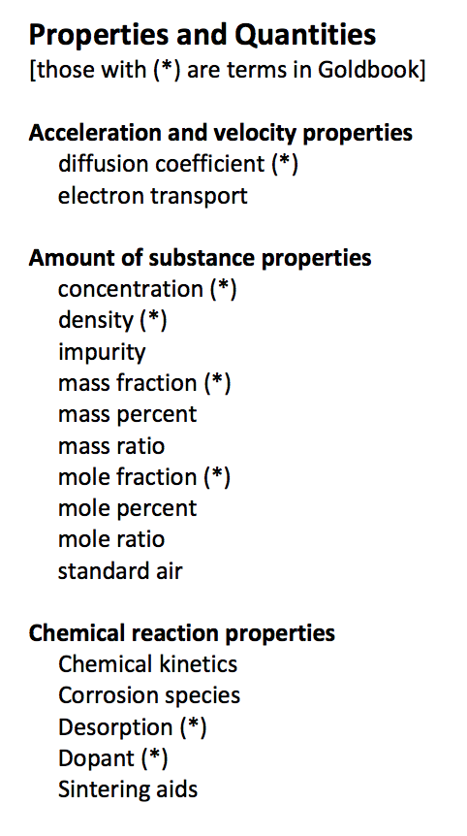

Slide 13
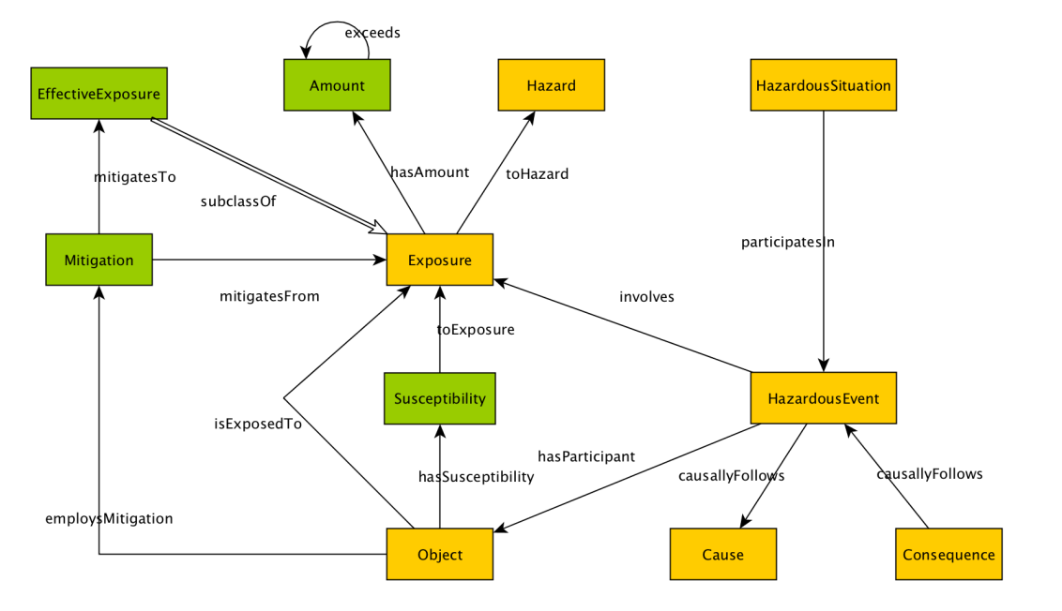
Modifying the Hazardous Situation Ontology Design Pattern
Magnitude
Response
Indicator
Outcome
Outcome
Appropriate Response Information Object
Effect
Lawrynowicz and Lawniczak. 2015
Cheatham et al. 2016
VoCamp 2016
Control
Exposure Route
PPE
Location Type
Person
Substance
Apparatus
Event
Notes:
VoCamp, unconference facilitated by members of the Vocabulary Services & Data Foundations and Terminology & Metadata Interest Groups
Approach is building frameworks from different ontology patterns
This framework capturing the right side of the bowtie, after a hazardous event
- Hazards in different contexts

Slide 14
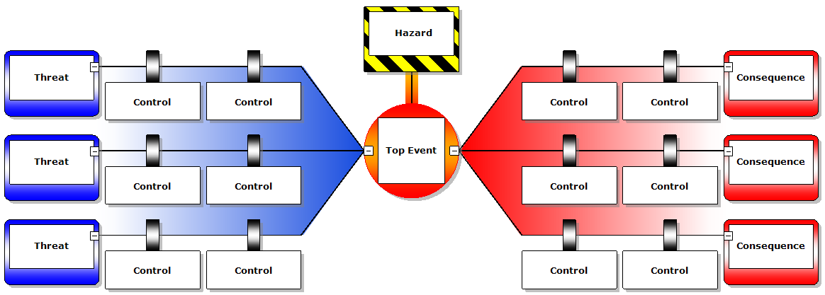
Lab Safety Model for Reported Incidents

Slide 15
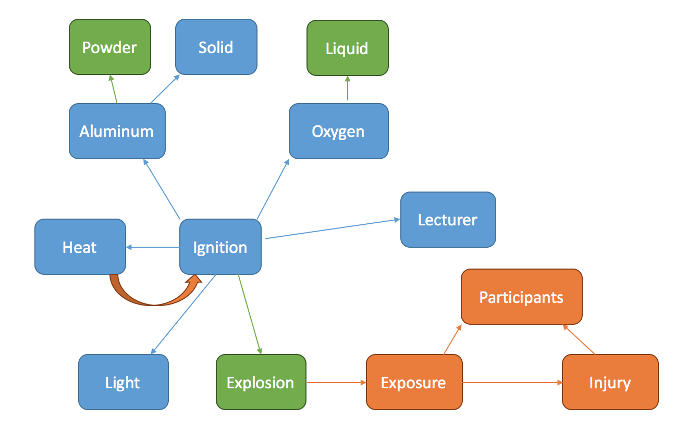
Experiment Process Factors
Condition
Form
Phase
Substance/reagent
Reaction role
Condition
Process/ operation
Apparatus/equipment
Condition
Operator
Outcome
(intended reaction)
Outcome (unintended reaction)
Adverse Event
Notes:
Basic concepts associated with a chemical lab process (early sketch, need chemistry)
This basic template addressing the left side of the bowtie, in normal processes before a hazardous event
-Fill in gaps

Slide 16
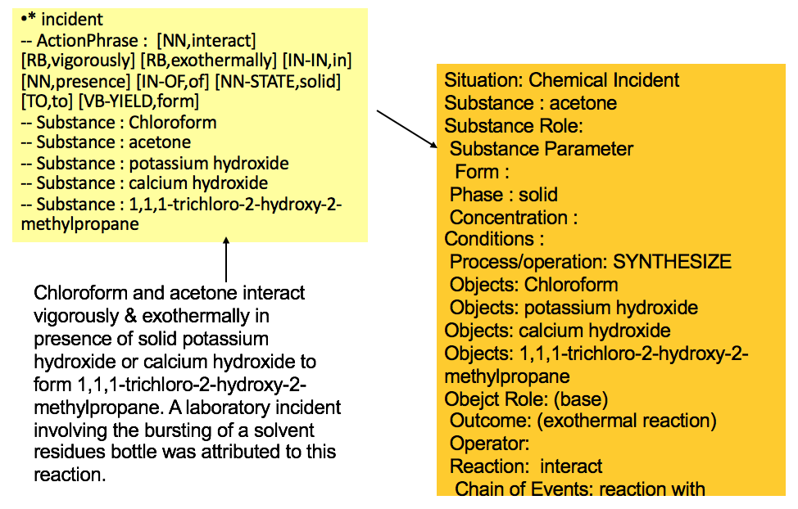
Safety Report to Structured Data
Text
Analyzed
Text
Populated
Template
Template
Start with free text, subjected to NLP analysis and harmonized with Safety Template Model
Notes:
Working on text analysis to structure the data set per the template
Two observations – how effective is NLP, and how well is template capturing concepts and relationships
Next steps – more analysis
Adapt templates
Incorporate templates into a tool

Slide 17
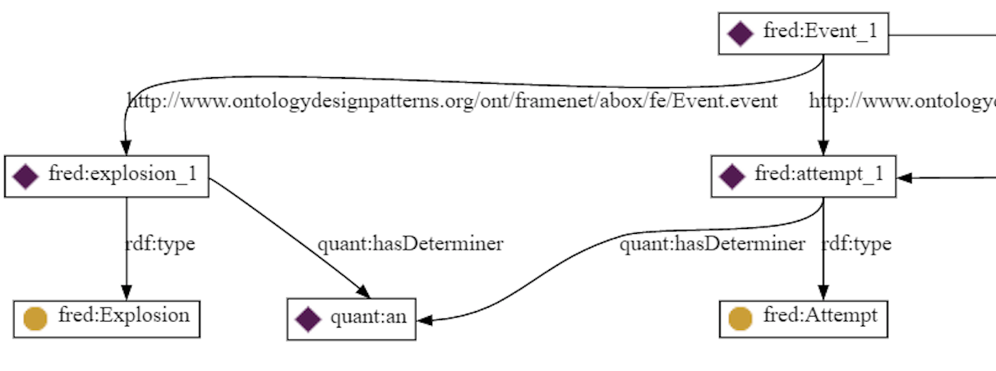
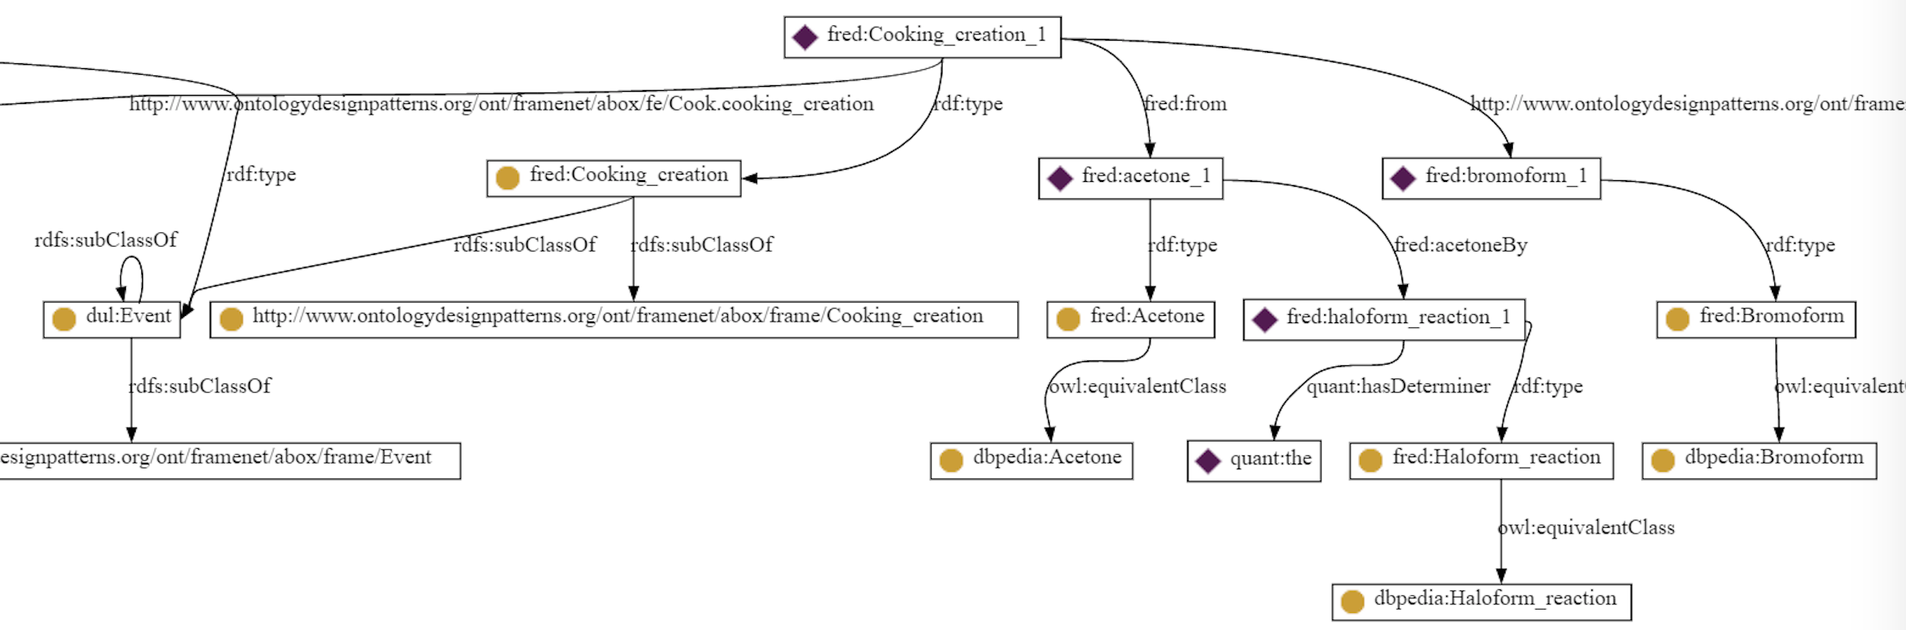
Discourse Representation
“An explosion occurred during an attempt to prepare bromoform from acetone by the haloform reaction.”
Presutti et. al, 2012
Notes:
Presutti, Valentina, Francesco Draicchio, and Aldo Gangemi. "Knowledge extraction based on discourse representation theory and linguistic frames." International Conference on Knowledge Engineering and Knowledge Management. Springer Berlin Heidelberg, 2012.
Example of parsing data into a pattern
Cooking may be a good analogy to a basic chemical lab process to represent these relationships
[top diagram continues to the left of the lower diagram]
Cooking creation involves these chemical ingredients and process (lower diagram)
Cooking creation is an event, one attempt of which was of type explosion (upper diagram)

Slide 18
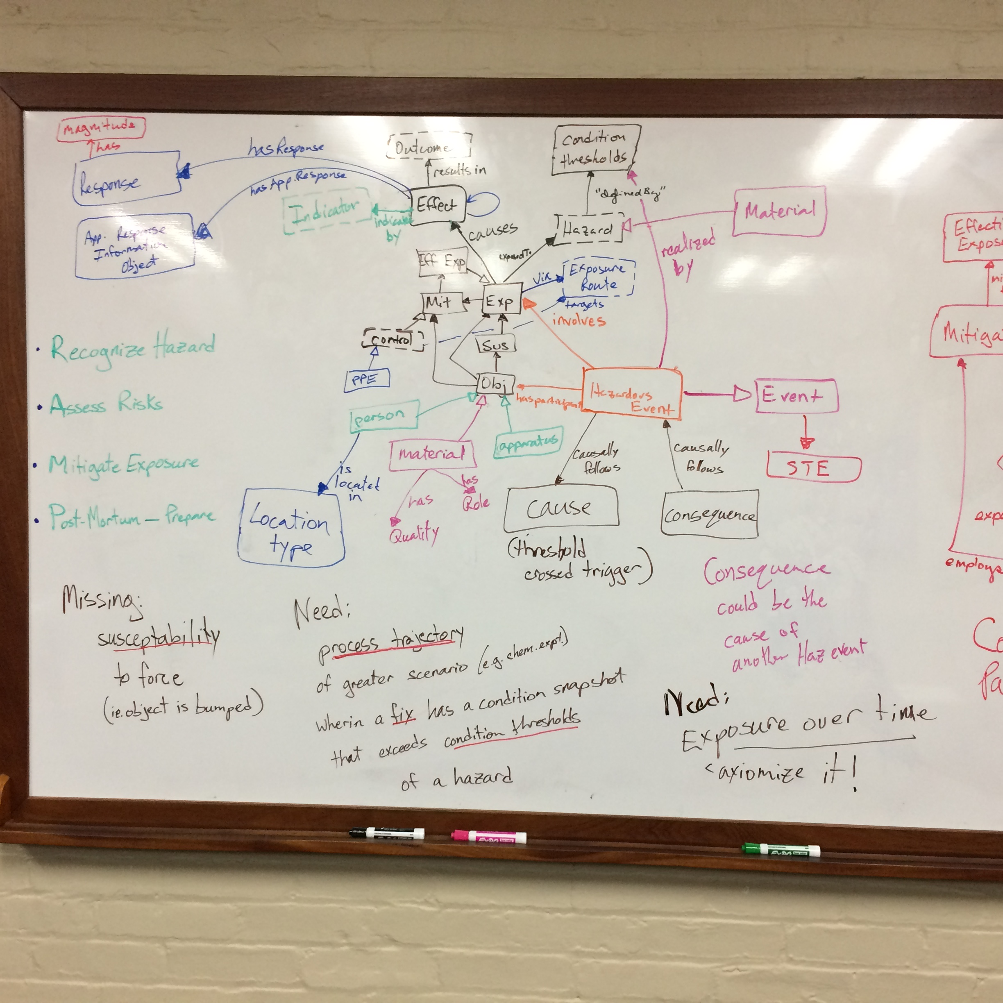
Notes:
interested in modeling the process sequence that leads up to a hazardous situation, as a complement to last year modeling the exposure and mitigation after a hazardous event
we identified the need for a process trajectory of the planned process (e.g., chemical experiment) wherein a fix has a condition snapshot that exceeds the condition thresholds that define a hazardous situation (e.g., temperature of a compound exceeds its flash point, load on a bridge exceeds its carrying capacity).
my hope is to start with a planned process, with the cross-over point into an unplanned hazardous process being associated with change in process conditions that reach a defined threshold.

Slide 19
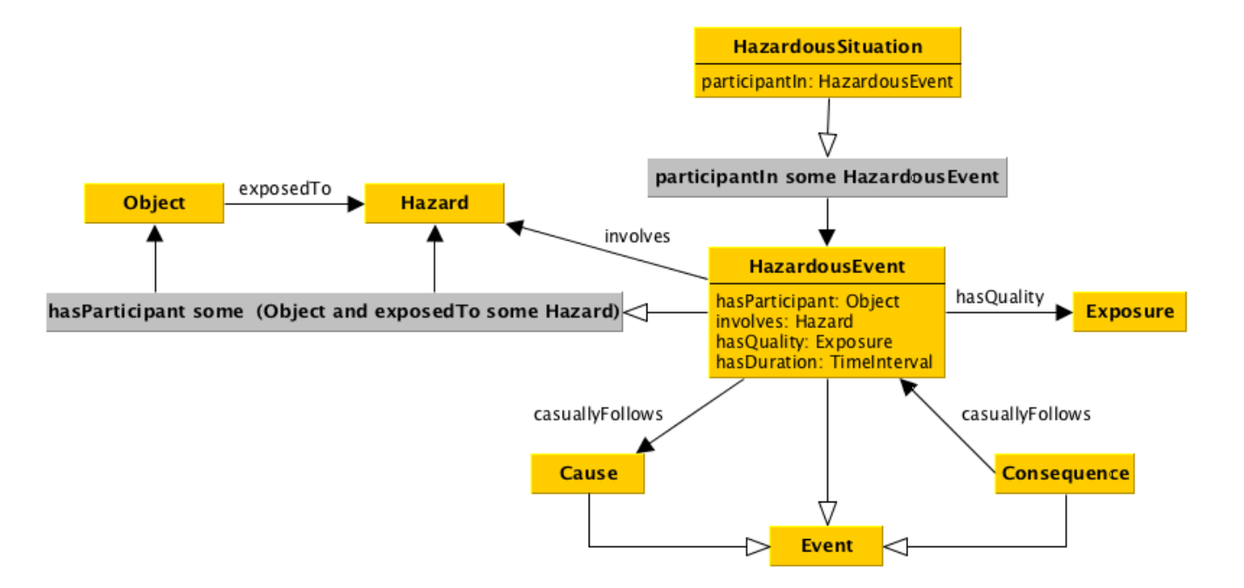
Hazardous Situation ODP
Lawrynowicz and Lawniczak. 2015
Notes:
Hazard & Risk ontology progression

Slide 20
What next?
Process more data
Refine template
Review with safety community
Annotate and search
:-)

